Slide 1
Value chain (hacking) rebels Step 3/8 – Validation

Slide 2
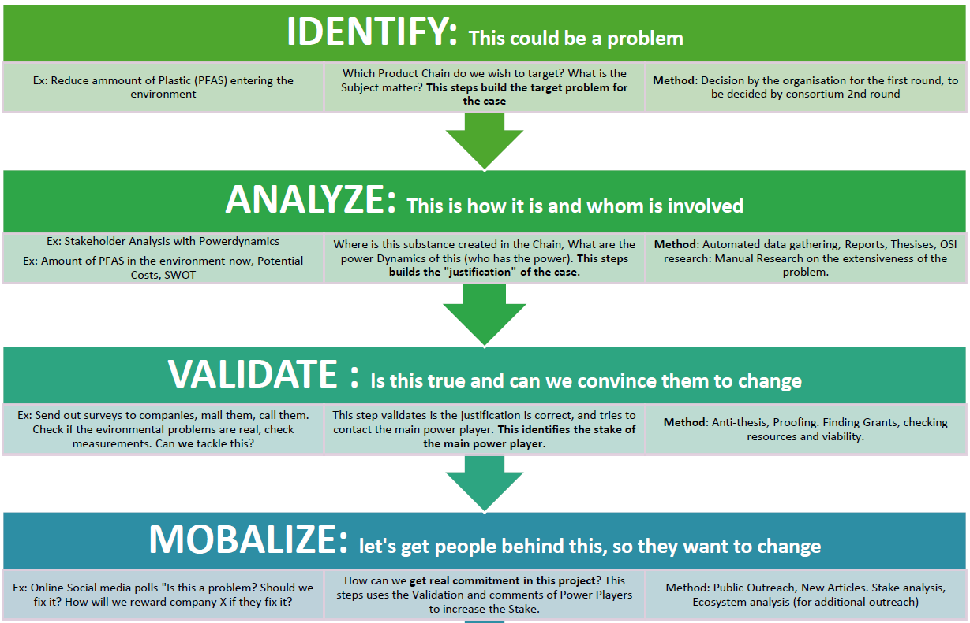
Step 3/8
Situation

Slide 3
Understanding our foundation
Situation
Identify
Task: primary goal setting, issue scope definition
Outcome: refined problem
Analyse
Task: value chain analysis & mapping
Outcome: dashboard to summarize refined problem & link it with relevant stakeholders

Slide 4
In summary…
Situation
Identify
Analyse
Radical change?

Slide 5
In summary…
Situation
Identify
Analyse
Radical change
Validation

Slide 6
In summary…
Situation
Critical lenses
Supply chain mapping
Radical change
Reality check

Slide 7
The constraints to work with
Situation
This project should
Aim for radical changes, not bandage
Be collaborative
This step should
Be timely
Be cheap
Overall
We’re just starting

Slide 8
What are the questions we want to answer?
Complication
On the supply chain mapping
Is the network mapped correct?
Are all key stakeholders identified?
Are the processes & products correct?
Does it help us visualise the problem?
Are the key metrics displayed and correct?
Can we see the first supplier (miner/farmer)?
Can we see the final customer?
Can we see the whole product life cycle?
Can we link a product/process to a social/environmental impact?

Slide 9
What are the questions we want to answer?
Complication
On the critical lenses
Is the problem relevant to academics?
Is the problem relevant to industries?
Is the problem relevant to the public?
What is the actual social & environmental impact of the problem?
What are the power players linked to this issue?
Which stakeholders want the problem solved? How powerful are they?
Have solutions be developed yet? Where are they at?
What is the financial feasibility of tackling the problem?
What is the practical feasibility of tackling the problem?

Slide 10
A simplified framework to problem validation
Execution strategy – the tool
We want to judge the provided critical lens & SC mapping
We want for it to be simple & done by verious persons
We want the output to be usable
As a proof that the critical lens/SC mapping are good to go to next step
OR as feedback to go back to step 1 and/or 2 for rework/refinement

Slide 11
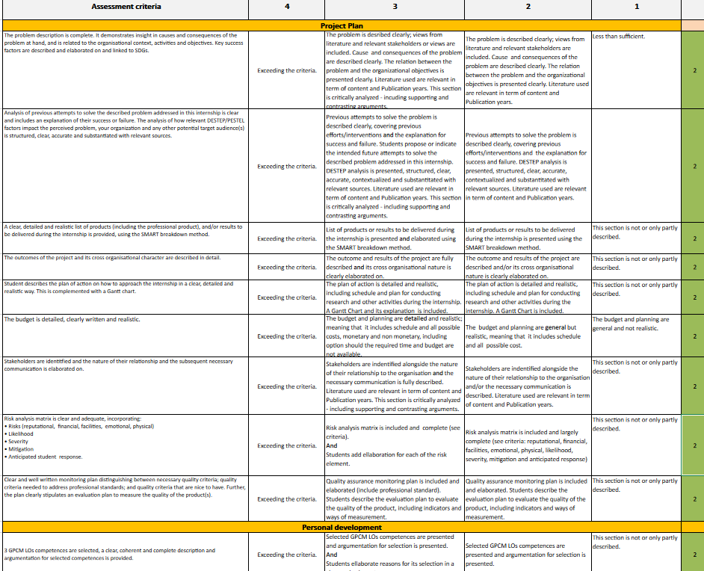
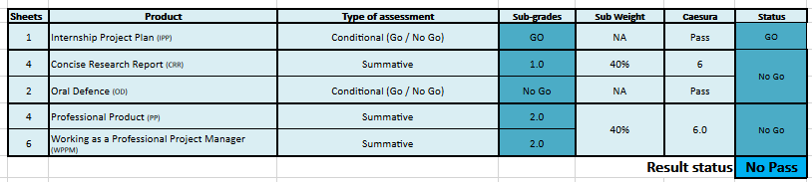
A simplified framework to problem validation
Execution strategy – the tool
Quick solution: the grading rubriek

Slide 12
How are we going to check what, how and with whom?
Execution strategy
At start
Surveys
Inteviews
Individual request
Ultimately
Focus group
Expert reviews
Public consultation
Survey/interview

Slide 13
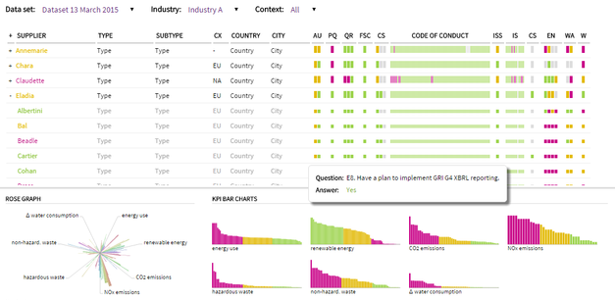
End goal, a dashboard to grade our SCM & Lens
List of criteria to grade the critical lens & supply chain mapping
The light in the horizon
Expert/participant | Current role | Background
Criteria a | Criteria b | Criteria c | … | Criteria n
Selected participant answering our survey, participating in focus groups, being interviewed…
Raw data/results from the questions asked
Comprehensive validation map of the critical lens & value chain mapping

Slide 14
Guarantees if step passed
Expected outcome
Confirmation of problem & critical lens relevance
Confidence in data gathered from SC mapping
Feasibility affirmation
Industry & expert interest ticked
Public support and awareness
Understanding of current impact
Anticipation of benefits

Slide 15
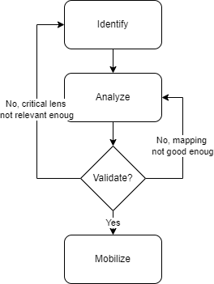
Part of a bigger picture
Expected outcome

Slide 16
Moving forward with confidence
Opening
Why should we make these steps a hackathon & how
Fast-tracking step 1-5 in 1-2 days
Make use of design/systems thinking
Engage students from the start
Involve & hook experts’ interest from the start (make them Jedis)
Create some clarity in the process
Hackathon at start of semester, show conference at the end
Create a steady rythm

Slide 17
ill you ask me questions?

